Slide 1
Naive Bayes Classification

Slide 2
Naive Bayes Classification
Suppose you are a product manager; you want to classify customer reviews in positive and negative classes.
Or As a loan manager, you want to identify which loan applicants are safe or risky?
As a healthcare analyst, you want to predict which patients can suffer from diabetes disease.
All the examples have the same kind of problem to classify reviews, loan applicants, and patients.

Slide 3
Naive Bayes is the most straightforward and fast classification algorithm, which is suitable for a large chunk of data.
Naive Bayes classifier is successfully used in various applications such as spam filtering, text classification, sentiment analysis, and recommender systems.
It uses Bayes theorem of probability for prediction of unknown class.

Slide 4
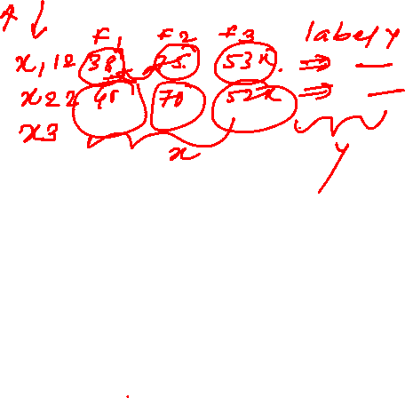
Classification Workflow
Whenever you perform classification, the first step is to understand the problem and identify potential features and label.
Features are those characteristics or attributes which affect the results of the label.
For example, in the case of a loan distribution, bank manager's identify customer’s occupation, income, age, location, previous loan history, transaction history, and credit score.
These characteristics are known as features which help the model classify customers.

Slide 5
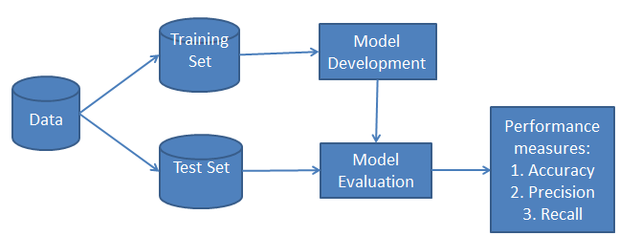
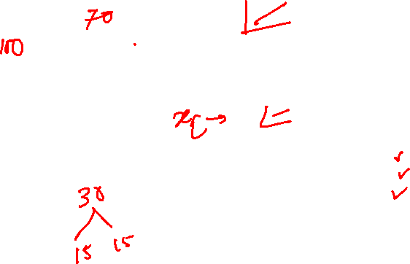
The classification has two phases, a learning phase, and the evaluation phase.
In the learning phase, classifier trains its model on a given dataset and in the evaluation phase, it tests the classifier performance.
Performance is evaluated on the basis of various parameters such as accuracy, error, precision, and recall.

Slide 6

What is Naive Bayes Classifier?
Naive Bayes is a statistical classification technique based on Bayes Theorem.
It is one of the simplest supervised learning algorithms. Naive Bayes classifier is the fast, accurate and reliable algorithm.
Naive Bayes classifiers have high accuracy and speed on large datasets.

Slide 7
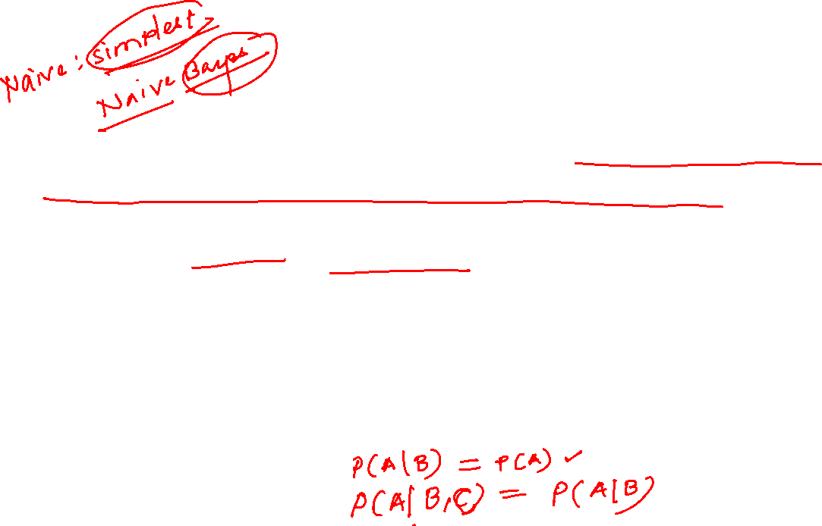
Naive Bayes classifier assumes that the effect of a particular feature in a class is independent of other features.
For example, a loan applicant is desirable or not depending on his/her income, previous loan and transaction history, age, and location.
Even if these features are interdependent, these features are still considered independently. This assumption simplifies computation, and that's why it is considered as naive.
This assumption is called class conditional independence.

Slide 8
How Naive Bayes classifier works?
Let’s understand the working of Naive Bayes through an example.
Given an example of weather conditions and playing sports. You need to calculate the probability of playing sports.
Now, you need to classify whether players will play or not, based on the weather condition.

Slide 9
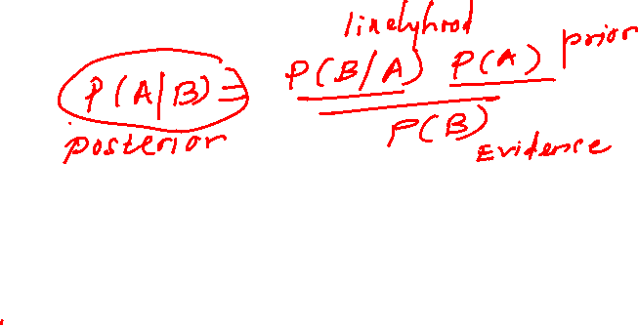
First Approach (In case of a single feature)
Naive Bayes classifier calculates the probability of an event in the following steps:
Step 1: Calculate the prior probability for given class labels
Step 2: Find Likelihood probability with each attribute for each class
Step 3: Put these value in Bayes Formula and calculate posterior probability.
Step 4: See which class has a higher probability, given the input belongs to the higher probability class.

Slide 10
For simplifying prior and posterior probability calculation you can use the two tables frequency and likelihood tables.
Both of these tables will help you to calculate the prior and posterior probability.
The Frequency table contains the occurrence of labels for all features.
There are two likelihood tables. Likelihood Table 1 is showing prior probabilities of labels and Likelihood Table 2 is showing the posterior probability.

Slide 11
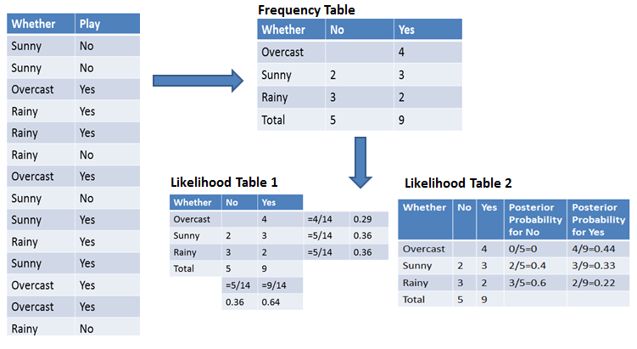
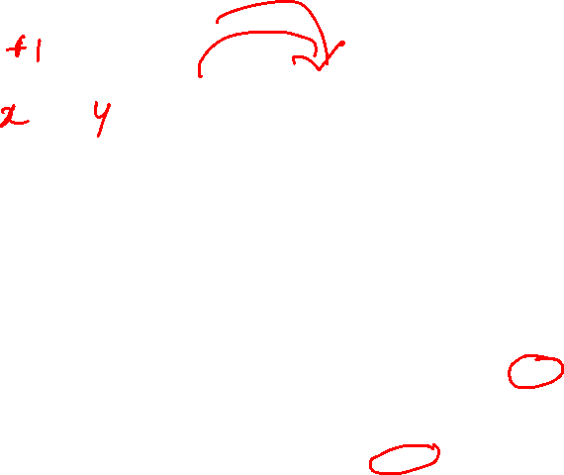

Slide 12
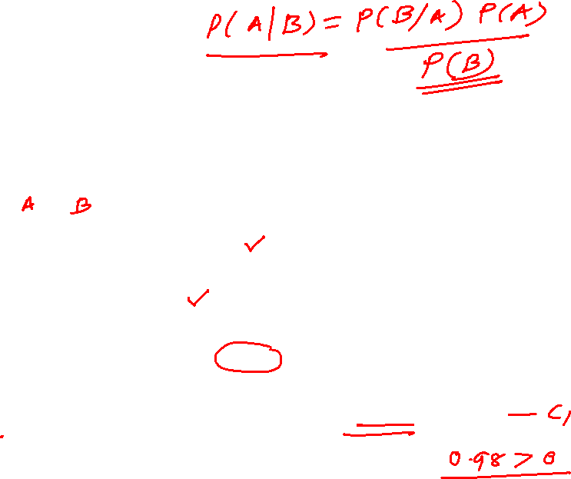
Now suppose you want to calculate the probability of playing when the weather is overcast.
Probability of playing:
P(Yes | Overcast) = P(Overcast | Yes) P(Yes) / P (Overcast) .....................(1)
Calculate Evidence probability
P(Overcast) = 4/14 = 0.29
Prior probability
P(Yes)= 9/14 = 0.64
Calculate likelyhood Probabilities:
P(Overcast |Yes) = 4/9 = 0.44
Put Prior and likelyhood probabilities in equation (1) to calculate posterior probability
P (Yes | Overcast) = 0.44 * 0.64 / 0.29 = 0.98(Higher)

Slide 13
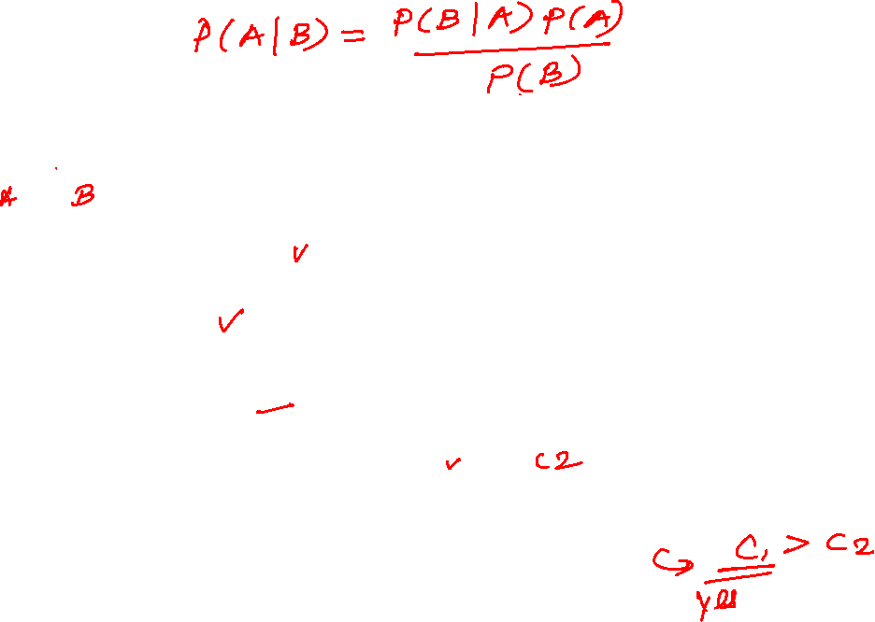
Probability of not playing:
P(No | Overcast) = P(Overcast | No) P(No) / P (Overcast) .....................(2)
Calculate Evidence Probabilities:
P(Overcast) = 4/14 = 0.29
Calculate prior probabilty
P(No)= 5/14 = 0.36
Calculate likelyhood Probability:
P(Overcast |No) = 0/9 = 0
Put these values to calculate Posterior probability in equation (2)
P (No | Overcast) = 0 * 0.36 / 0.29 = 0
The probability of a 'Yes' class is higher. So you can determine here if the weather is overcast than players will play the sport.

Slide 14
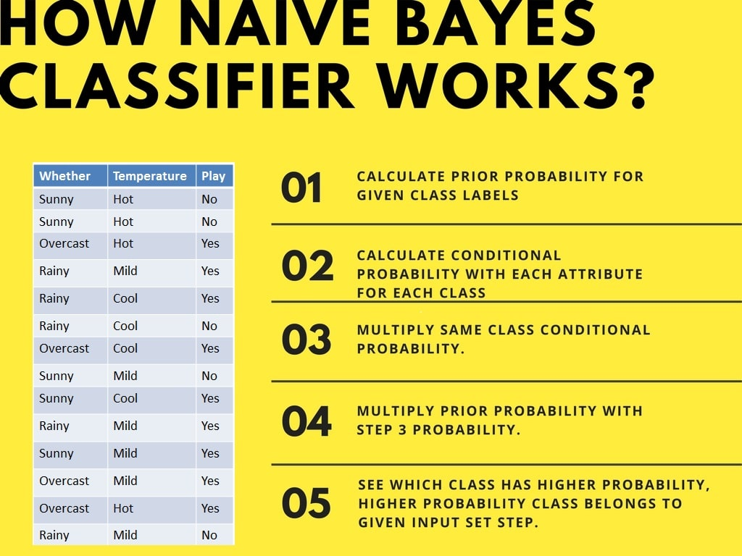
Second Approach (In case of multiple features)

Slide 15
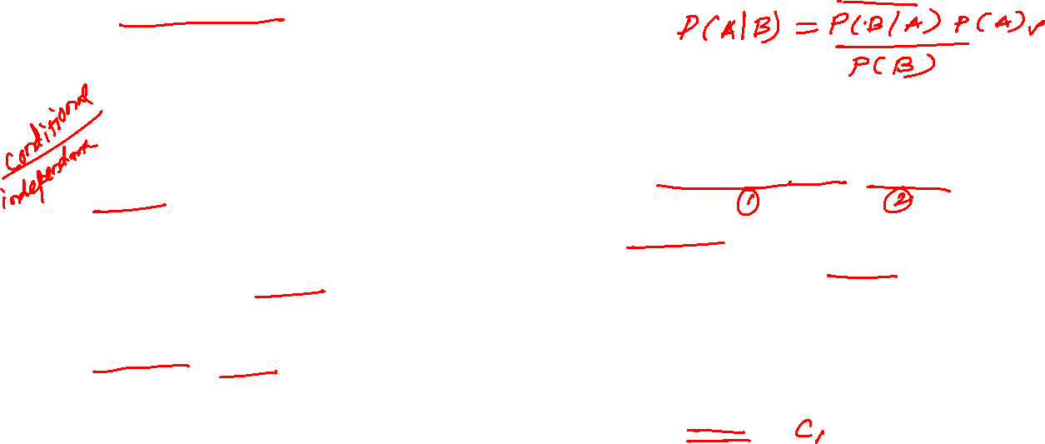
Now suppose you want to calculate the probability of playing when the weather is overcast, and the temperature is mild.
Probability of playing:
P(Play= Yes | Weather=Overcast, Temp=Mild) = P(Weather=Overcast, Temp=Mild | Play= Yes)P(Play=Yes) ..........(1)
P(Weather=Overcast, Temp=Mild | Play= Yes)= P(Overcast |Yes) P(Mild |Yes) ………..(2)
Calculate Prior Probabilities: P(Yes)= 9/14 = 0.64
Calculate likelyhood Probabilities: P(Overcast |Yes) = 4/9 = 0.44 P(Mild |Yes) = 4/9 = 0.44
Put likelihood and prior probabilities in equation (2) P(Weather=Overcast, Temp=Mild | Play= Yes) = 0.44 * 0.44 = 0.1936(Higher)
Put Prior and likelihood probabilities in equation (1) P(Play= Yes | Weather=Overcast, Temp=Mild) = 0.1936*0.64 = 0.124

Slide 16
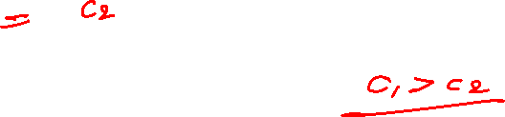
Similarly, you can calculate the probability of not playing:
Probability of not playing:
P(Play= No | Weather=Overcast, Temp=Mild) = P(Weather=Overcast, Temp=Mild | Play= No)P(Play=No) ..........(3)
P(Weather=Overcast, Temp=Mild | Play= No)= P(Weather=Overcast |Play=No) P(Temp=Mild | Play=No) ………..(4)
Calculate Prior Probabilities: P(No)= 5/14 = 0.36
Calculate likelyhood Probabilities: P(Weather=Overcast |Play=No) = 0/9 = 0 and P(Temp=Mild | Play=No)=2/5=0.4
Put likelyhood probabilities in equation (4) P(Weather=Overcast, Temp=Mild | Play= No) = 0 * 0.4= 0
Put prior and posterior probabilities in equation (3) P(Play= No | Weather=Overcast, Temp=Mild) = 0*0.36=0
The probability of a 'Yes' class is higher. So you can say here that if the weather is overcast than players will play the sport.

